Slide 1

Inflation Dynamics in the US
Bonyshree Bose
Kanha Baidya
Yashesh Darji
Anirudh Bhamidipati

Slide 2
Agenda
CPI Calculation and its Components
Each Components relative size in CPI Calculation across US and US regions
Inflation Trends in the United States for last decade or so
Relationship between CO2 emission and Agriculture Value Added %
Analyze Inflation across US major cities and US regions for Housing and Education sector
Relationship between CPI , HPI, Mortgage Rates and Tuitions

Slide 3
Let’s talk about Inflation
What is inflation?
Inflation is an overall increase in the prices of goods or services in an economy.
Reasons for Inflation?
Inflation can occur for a variety of reasons, like higher wages, lower interest rates, supply chain issues, or broader issues in the global economy.

Slide 4
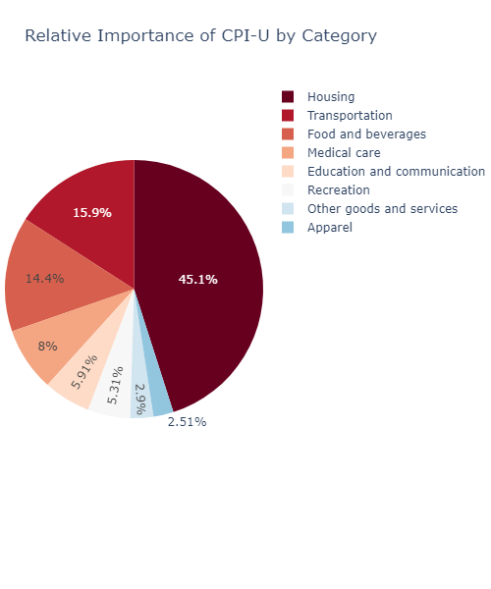
How is inflation measured?
Consumer Price Index for Urban Consumers (CPI-U) (Published by Bureau of Labor Statistics)
Average change in the prices of consumer goods and services
Prices in the CPI-U are given a weight based on their relative importance
Census regions: Northeast, South, Midwest, West

Slide 5
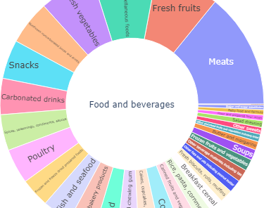
Meat and Fresh Fruits weightage is the highest in the Food and Beverages component

Slide 6
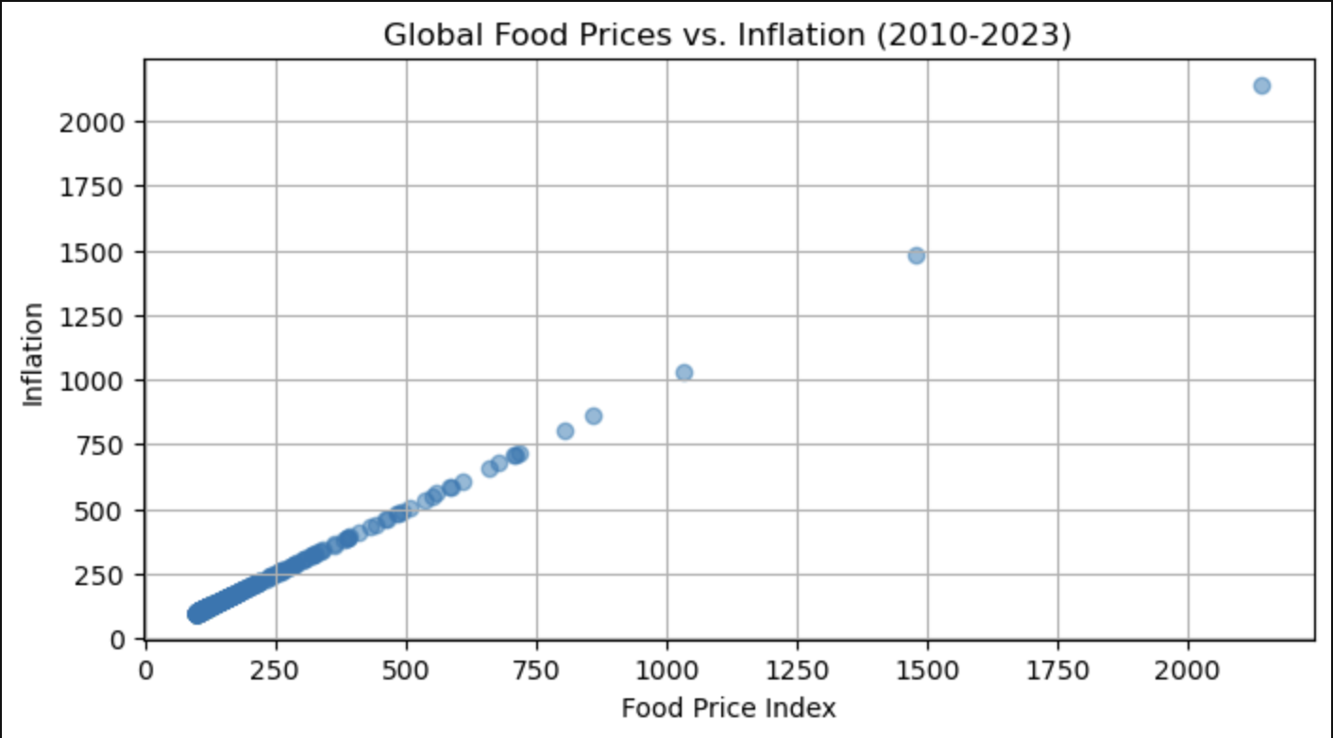
Global Food Prices vs Inflation
Positive correlation exists between the Food Price Index and Inflation between 2010-2023. Looking into the outliers shows the increase in Food Prices as inflation has gone up overtime.

Slide 7
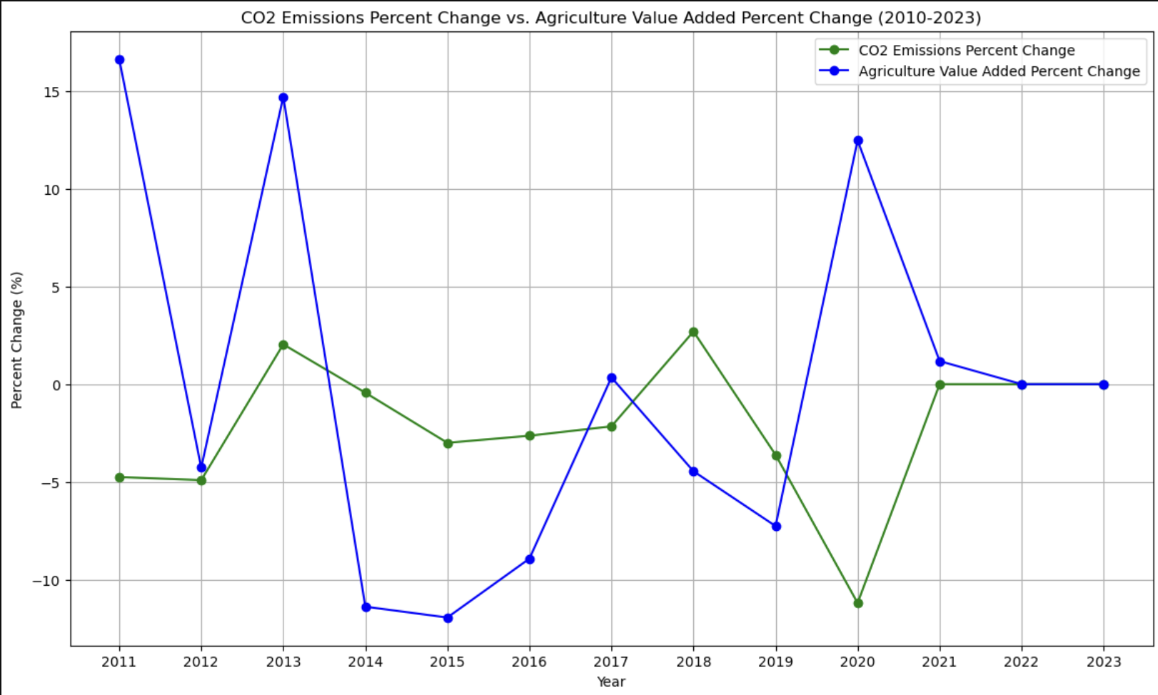

Slide 8
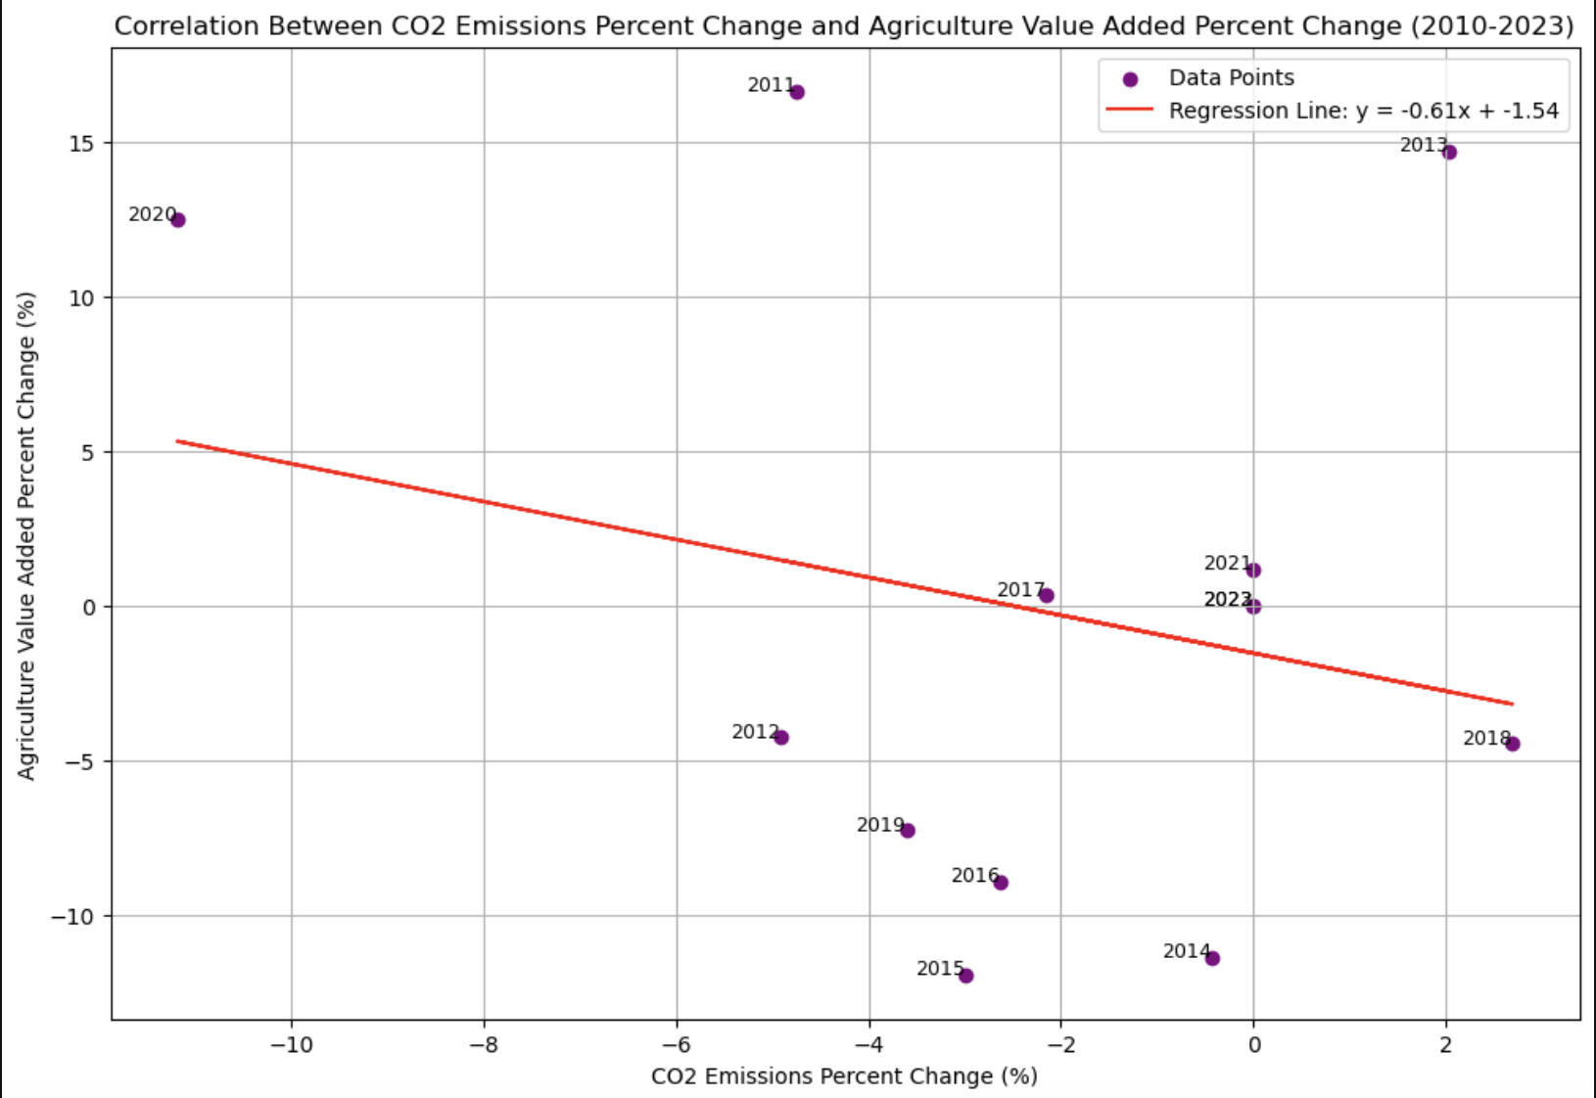
Correlation between Co2 emission and Agriculture Value Added % Change over the years is -0.23
Notes:
Negative correlation exists between CO2 emission % Change and Agriculture Value Added %. The same indicates indicates this correlation will help improve Agricultural Sector that may reduce prices for Food and Beverages.

Slide 9
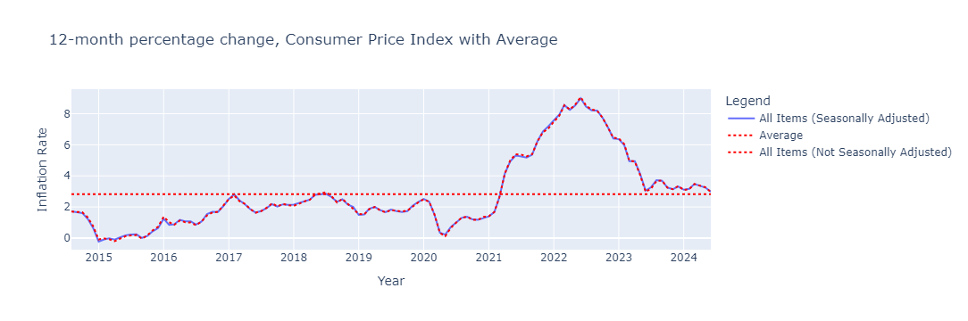
Average Inflation Rate Change for all Urban Customers

Slide 10
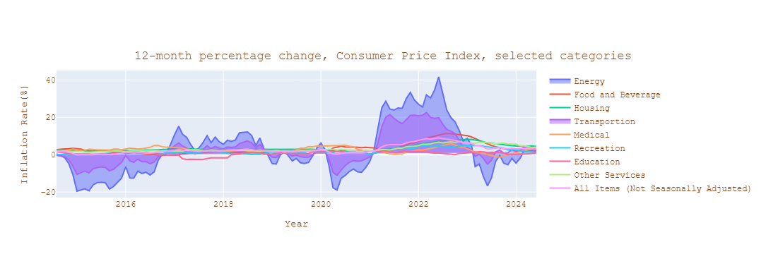
Inflation Rate Change
Change in the 8 subcomponents since 2014
Notes:
The chart below shows the cumulative percent change in price for each of the eight categories since 2014

Slide 11
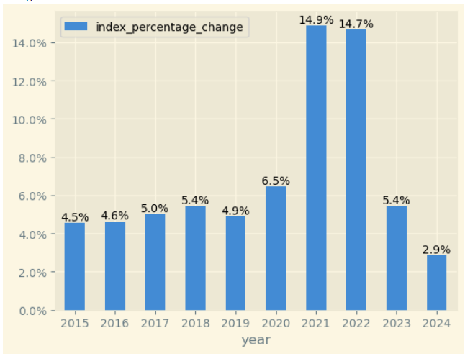
HPI increased by 14.9% due to Covid Pandemic in 2021

Slide 12
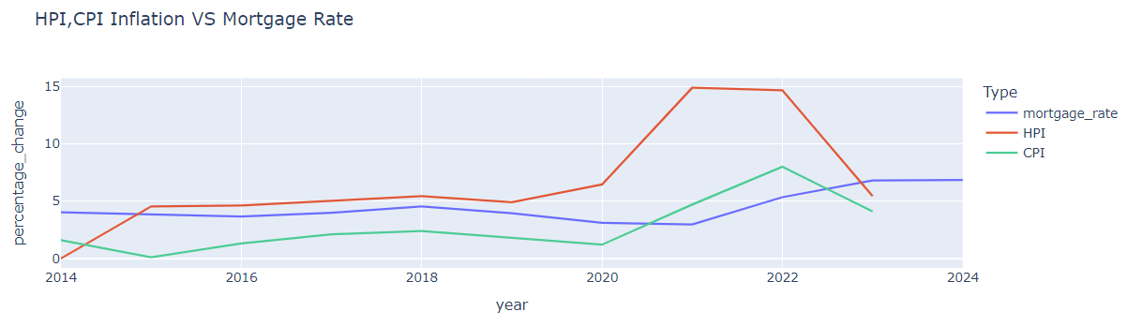
Notes:
Mortgage rate has been pretty constant from 2013 to 2020. In 2020 during covid pandemic times, CPI and HPI started to rise but Mortgage Rate didn’t change until 2021.

Slide 13
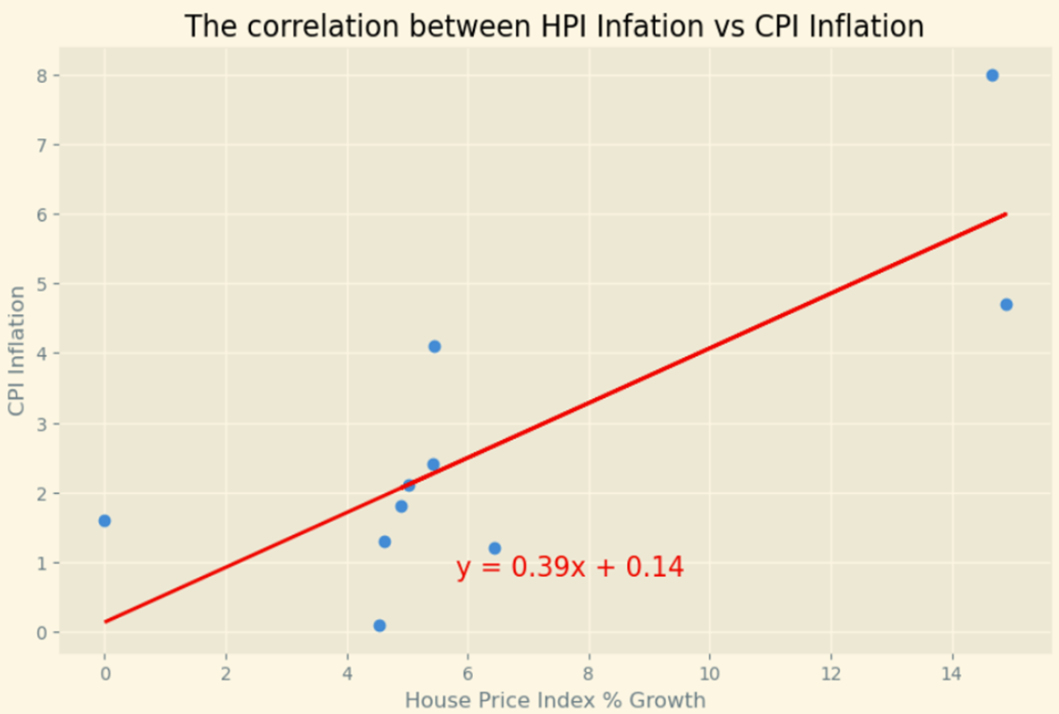
Calculated Correlation Coefficient is 0.79 indicating Strong correlation between HPI and CPI
Notes:
A correlation coefficient of 0.79 indicates a strong positive correlation between the HPI (House Price Index) and CPI (Consumer Price Index). This means that as the House Price Index increases, the Consumer Price Index also tends to increase, and vice versa.

Slide 14
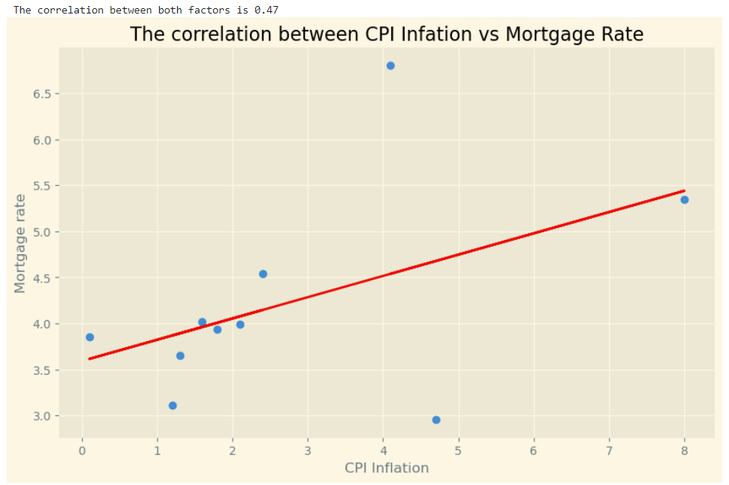
Calculated Correlation Coefficient is 0.47 indicating Strong correlation between Mortgage Rate and CPI
Notes:
Increase in Inflation, HPI and Mortgage rate goes hand in hand as they all are strongly correlated to each other. A correlation coefficient of 0.47 indicates a moderate positive correlation between Mortgage Rate and CPI. In the table we discussed earlier, a correlation coefficient between 0.5 and 0.7 is considered a moderate correlation. Therefore, in this case, there is a moderate positive correlation between Mortgage Rate and CPI.

Slide 15
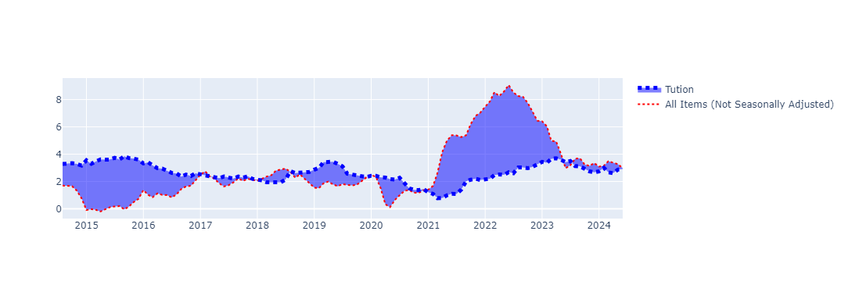
CPI for All Urban Consumers: Tuition, Other School Fees, and Childcare in U.S. City
Notes:
The price of tuition, other school fees and child care rose steadily after 2015, as can be seen in the first figure. But as consumer purchases were increasing at roughly the same pace over the next few years, the price of tuition, schooling fees and child care relative to the CPI becoming noticeably flatter. Then, it dips strongly during 2021-22 as overall inflation in the U.S. peaks. Currently(2024) its up by 1.53% compared to 2021.

Slide 16
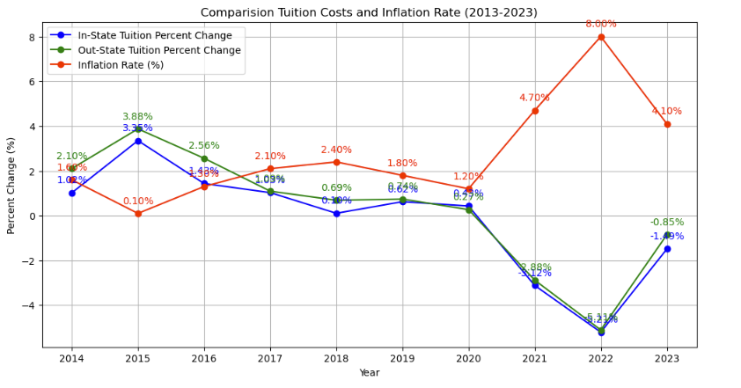

Slide 17
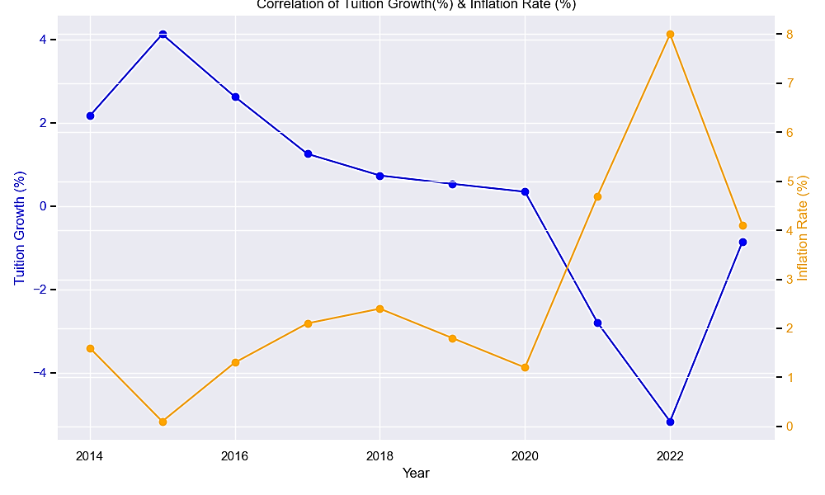
Strong Negative Relation between
Inflation and Tuition Fee % Change
Correlation Coefficient -0.951

Slide 18
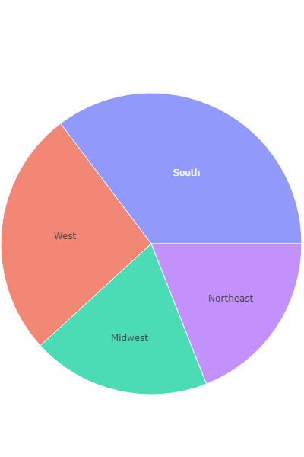
Expenditure weights, for U.S. regions, 2024

Slide 19
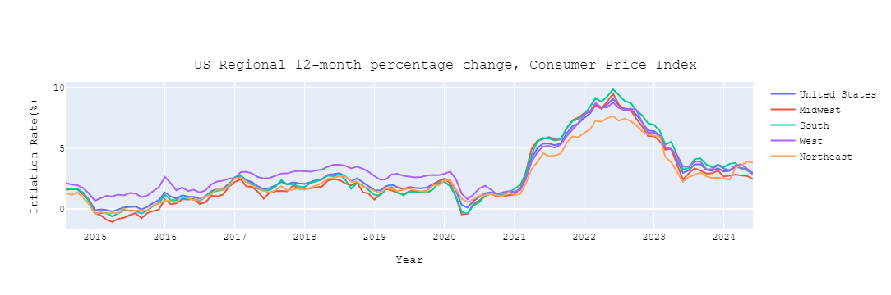
Annual Consumer Price Index inflation using U.S. expenditure weights and regional price changes
Notes:
South East and Midwest have reported larger increase in consumer prices in last decade or so.

Slide 20
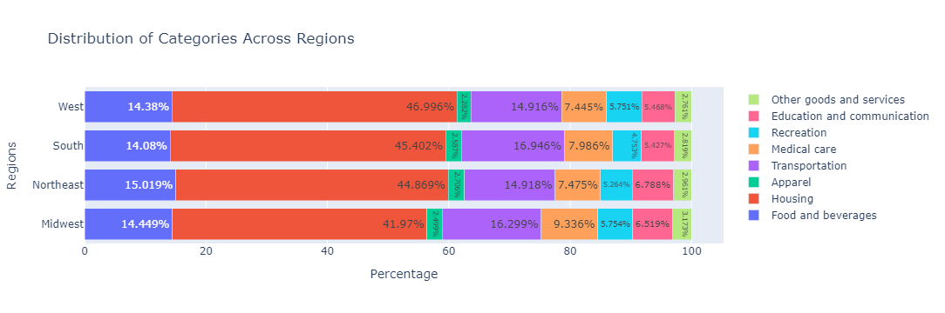
Expenditure weights, by category, for U.S. regions, 2024
Notes:
In the Southern Region, the expenditure weight on Transportation and Medical Care is higher compared to the West Region, which has the highest expenditure weight on Housing among all regions. Education weightage is highest in the NorthEast Region.

Slide 21
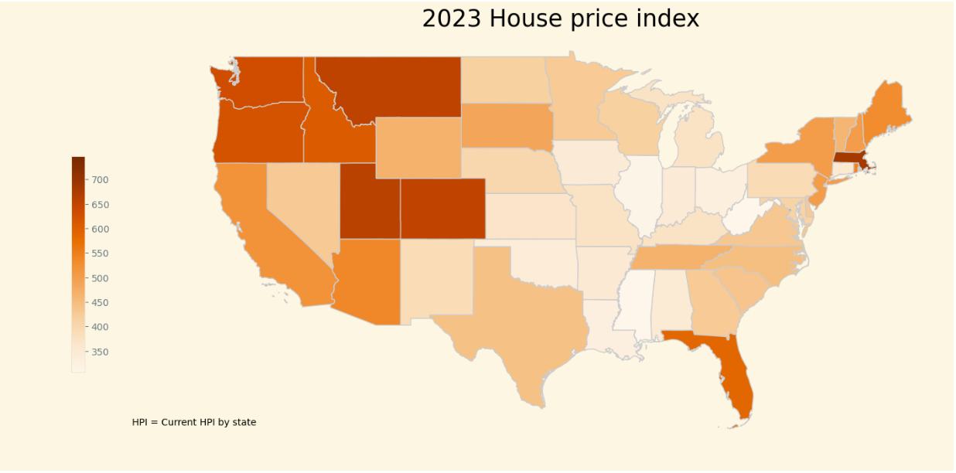
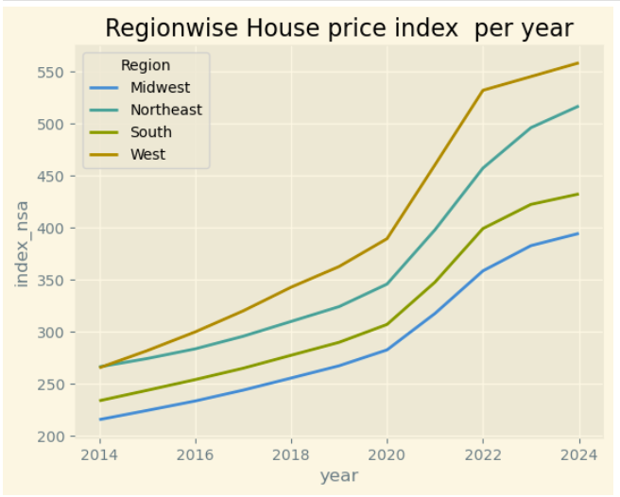
Notes:
Both HPI rise and expenditure weightage of Housing Sector in the CPI calculation is the highest for West Region. So increase in housing price in West Region will have impact inflation % in this region more compared to other regions.

Slide 22
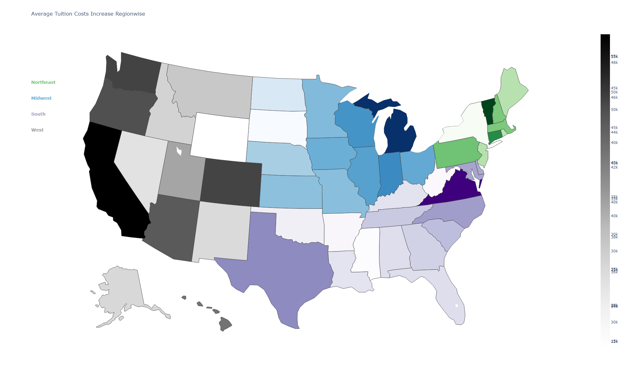
Northeast States Tops the Tuition Fee Expense
South States with Lower Tuition Fee Expense

Slide 23
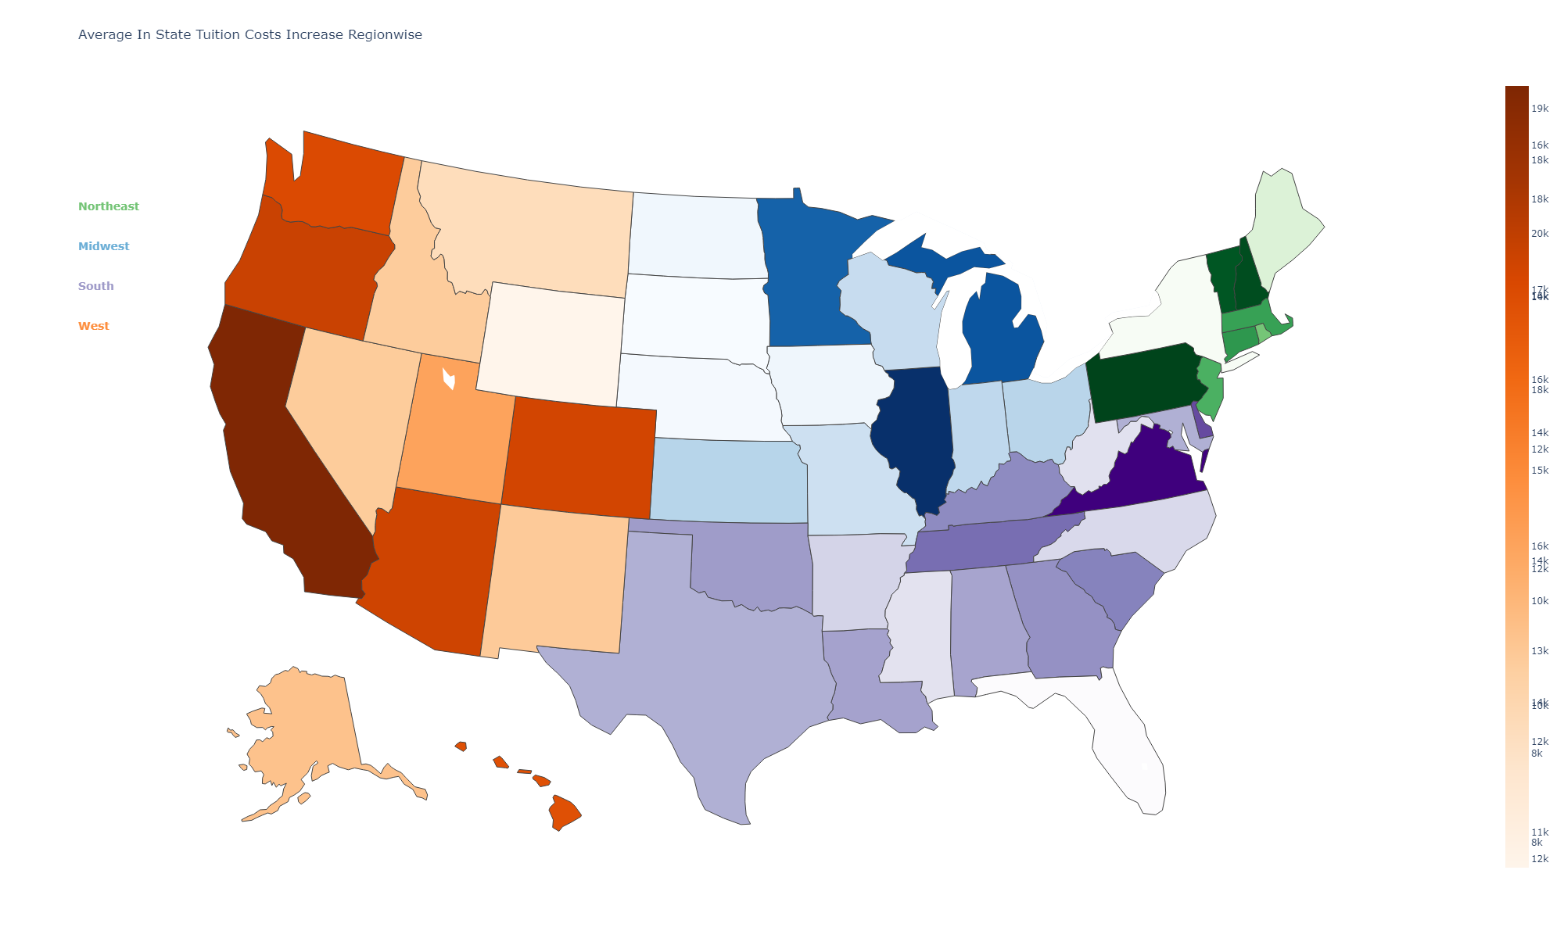
Notes:
In the NorthEast Region, the expenditure weight on Education is the highest in the calculation of CPI but its share to the overall expenditure is only 6.7% . So even though Tuition Fee in-state and out-state is highest in NorthEast Region, the inflation in these states would not be driven by it.

Slide 24
Conclusions:
Inflation Rates in US did rise drastically on the start of covid pandemic and reached 6.19% by mid of 2022. In the year 2023, the inflation rate started to come down and now in 2024 it’s 2.98% that’s close to the value before Covid.
During covid pandemic times, CPI and HPI started to rise but Mortgage Rate didn’t change until 2021. We found correlation between CPI and HPI is higher than CPI and Mortgage rate.
Both HPI and Housing Sector expenditure weightage in the CPI calculation is the highest for West Region. So increase in housing price in West Region has impacted inflation rate in this region more compared to other regions.

Slide 25
The price of tuition, other school fees and child care rose steadily after 2015. Then, it dips strongly during 2021-22 as overall inflation in the U.S. peaks. Currently(2024) its up by 1.53% compared to 2021. It seems tuition and inflation are negatively correlated. So, rise in inflation reduces the customer spending in Tuition.
Northeastern and Western states show consistently higher tuition costs, both for in-state and out-state type of students. Inflation in years 2020 to 2023 has caused decline in tuition costs from years 2020 to 2023.

Slide 26

Thank You
Any Questions, Comments & Concerns?
Analysis performed by:
Bonyshree Bose
Kanha Baidya
Anirudh Bhamidipati
Yashesh Darji
Notes:
NOTE:
To change the image on this slide, select the picture and delete it. Then click the Pictures icon in the placeholder to insert your own image.

